Slide 1

Seeking help in times of trouble
Starting conversations about mental health with hair and beauty industry
students

Slide 2
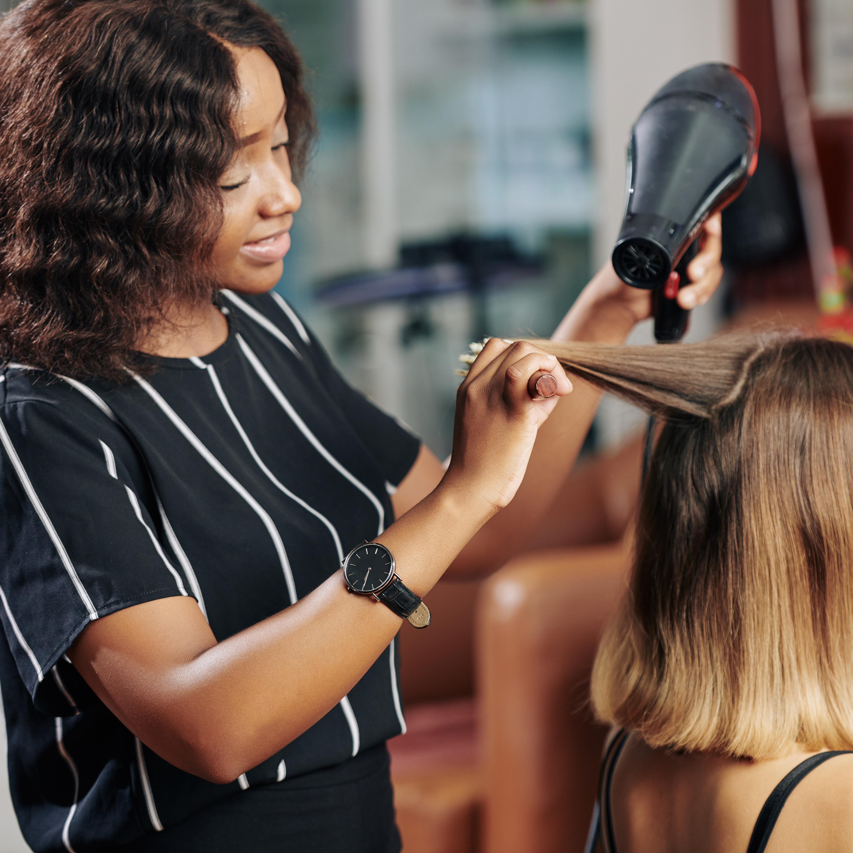
Feeling unwell
You have had a headache for several days and your vision is blurred.
You feel too unwell for work or college.
What might you do?

Slide 3
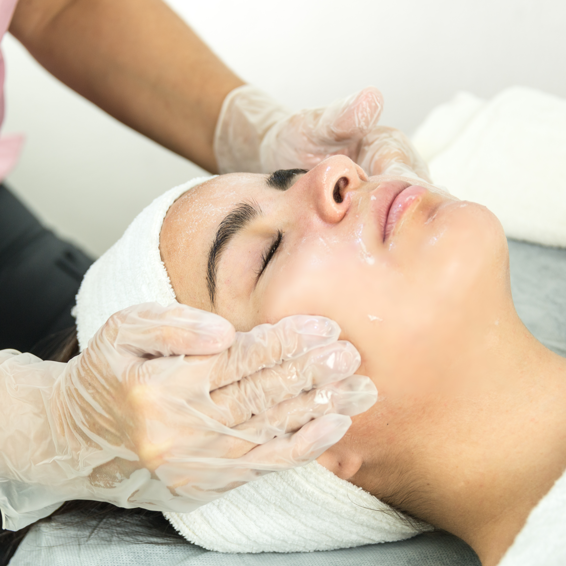
Feeling unwell
You have been feeling down and anxious for several days and dread getting up for college or work.
What might you do?

Slide 4

Feeling unwell
Why might it be harder to ask for help with an emotional problem than a physical one?

Slide 5
Activity A
What is stress?
“The adverse reaction people have to excessive pressure or other types of demand placed on them”
Health & Safety Executive, HSE

Slide 6
Activity B
What’s in your stress container?
Stress flows
into the container
If the container
overflows, problems develop –
‘emotional” snapping
Helpful coping strategies
=
Tap lets
stress out
Unhelpful coping strategies
=
Tap blocked so water fills the container and overflows

Slide 7
Unhelpful coping strategies
Stressors
Unhelpful strategies
Healthy balance
cannot be achieved

Slide 8
Helpful coping strategies
Stressors
Helpful strategies
Healthy balance
is achieved

Slide 9
I survived jumping off the Golden Gate Bridge
Play YouTube video
www.youtube.com/watch?v=WcSUs9iZv-g&feature=youtu.be

Slide 10
Samaritans
Visit website
https://www.samaritans.org/scotland/how-we-can-help/if-youre-worried-about-someone-else/myths-about-suicide/

Slide 11
The barber providing mental health support to men
Visit website
https://www.youtube.com/watch?v=vvaOCqCnjGc

Slide 12
Support in the UK and the college
View literature
www.samaritans.org/how-we-can-help-you/contact-us
(Any age)
www.themix.org.uk/about-us/goodbye-childline-hello-themix
(Age 18-25)
Student Welfare and Participation Team for Counselling or College Nurse

Slide 13

Seeking help for emotional problems
If someone you know was feeling really low and desperate who could they talk to?

Slide 14



Students Against Depression
Visit studentsagainstdepression.org

Slide 15
Charlie Waller Trust
First Floor, Rear Office • 32 High Street
Thatcham • Berkshire RG19 3JD
01635 869754 • hello@charliewaller.org

